Slide 1

Capstone Project-2
Yes_Bank_Stock_price_Prediction

Slide 2

Content:-
1.Business Context
2.Objective
3.Data Summary
4.EDA
5.Model Training
6.Target Feature
7.Model Implementation(Train,test,split)
8.Regularization
9.Challenges
10.Conclusion

Slide 3
Business Context
In this Finance word stock trading is one of the most important activity.It is an act trying to determine the future value of stocks as well as other financial instruments traded on a financial exchange.Basically quantitative trader with a lot of money from stock markets buy stock derivatives and equities at a cheap price and later on selling them at a high price.To determine these Yes bank stock we need to perform future value on the national stock exchange by making machine learning model of linear regression.

Slide 4
Objective
1.To determine the best fit model for stock exchange application.
2.with the help of attributes we are able to visualize best features.
3. To determine the future movement of the stock value of a financial exchange.
4.To gain the significance profit from prediction.
5.To Know the future scope of market.

Slide 5
Data Understanding
In this yes_bank_stock_closing price prediction project,
we have 4 attributes(Columns) and 185 rows are present .
Attributes are (Date,High,low,close and open).
Date is only of object data type and we need to convert it in to int data type.
Open,high,low and close are integer data type.

Slide 6
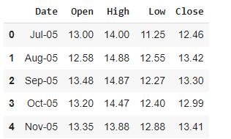
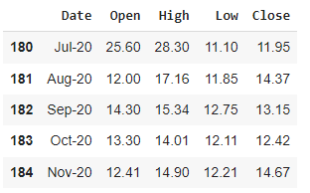
contd…
Data summary
Head data top 5 rows Tail data bottom 5 rows

Slide 7
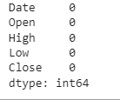
Exploratory Data Analysis
In this Preliminary phase we need to clean the data find out missing values.
if present then need to replace this with respect to mean mode and median.
As of now there is no missing value is present.
No duplicate values.
Only we need to convert object (Date) Data type into int data type.

Slide 8
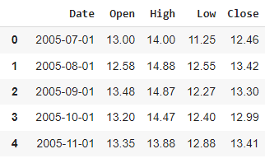
Data Cleaning
In the Data cleaning part we are importing datetime so date will come in proper format of date.so before Date feature has data type of object we need to convert it into yyyy-mm-dd format.

Slide 9
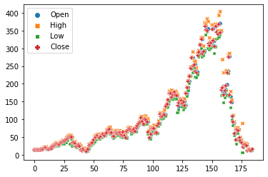
Lets Try to Analyze Data with respect to Close Price
As we know we are predicting our closing price so our target variable is “Close” which is in continuous data type.
Let’s do the Scattering plot for independent and dependent variable.

Slide 10
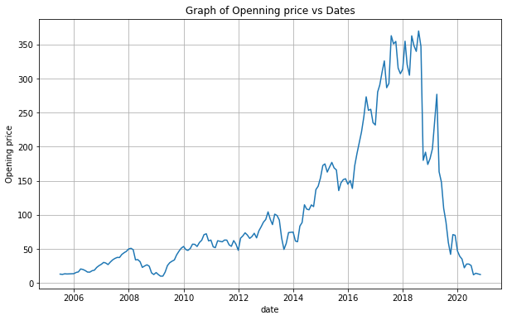
Plot for Open price with Dates:

Slide 11
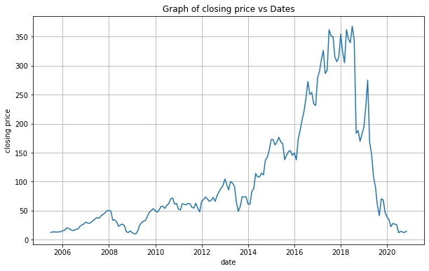
Plot For Close price with dates

Slide 12
contd…
So from above graph of yes bank open price and yes bank closing price its seem like both graphs have same results.
Opening price is started to increasing from 2016 and having its peak point in the year of 2018 and laying down is started from in range year of 2019-20
Same as for Closing price is started to increase from 2016 and having its max peak point is 2018 and falling 0 in year of 2019-20

Slide 13
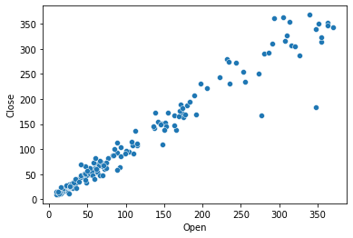
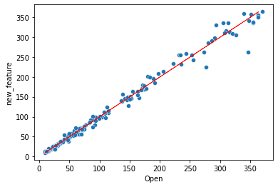
Bivariate Analysis
Open VS Close Open vs New_features

Slide 14
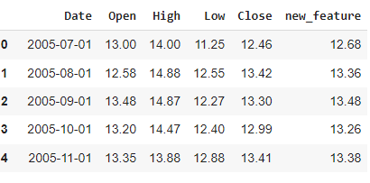
contd…
In above scatter plot we can conclude that bivariate analysis shows high correlation of close price with other features.also shows correlation between each other.
In the new_feature we take an average mean of whole(high,low,open).here also all feature are strongly correlated with each other.

Slide 15
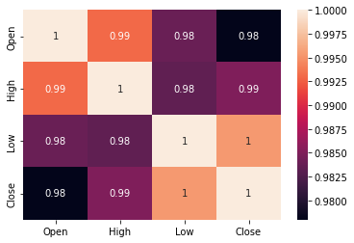
Correlation between all variable
This Graph shows that correlation between all variable.All of feature shows high correlation between each other

Slide 16
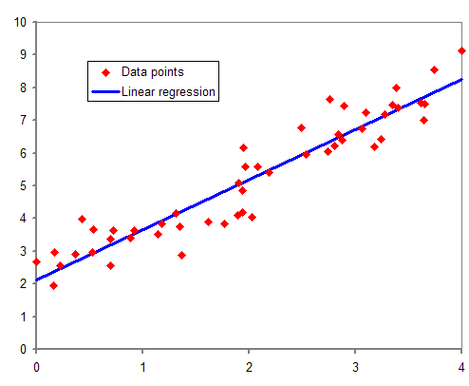
Model Training
Linear Regression:-
It is a supervised machine learning algorithm.It is a predictive model which predicts the relationship between dependent and independent variable.
It follows the equation y=mx+c,
Where m=intercept,c=slope

Slide 17
Best Fit Line:-
The line which contains the relationship between maximum data points thats draw a linear line through the points.
Residual Error=(Ya-Yp)^2

Slide 18
Cross-Validation:-
There is always the need to test the stability of the model. It means based only on the training dataset; we can't fit our model on the training dataset. For this purpose, we reserve a particular sample of the dataset, which was not part of the training dataset.
So the conclusion,the R-squared value for test data was 98% and this what same as training dataset which proves that we can achieve the best fit model.

Slide 19
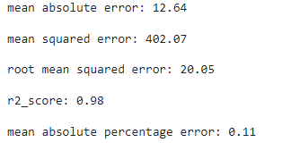
Lasso Regression:-
Known as L1 Regularization.it reduces the model complexity.It stands for least absolute and selection operator.
It takes absolute values hence it can shrink the slope to 0,penalty terms contains only the absolute weights instead of square of weights.(Lamda*|slope|)

Slide 20
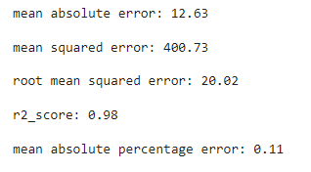
Ridge Regression
Known as L2 regularization.Because of some cost function in ridge regression.The regression reduces the amplitude of coefficient that decreases the amplitude of coefficient .
It reduces the complexity of model.(lambda*(slope)^2)

Slide 21
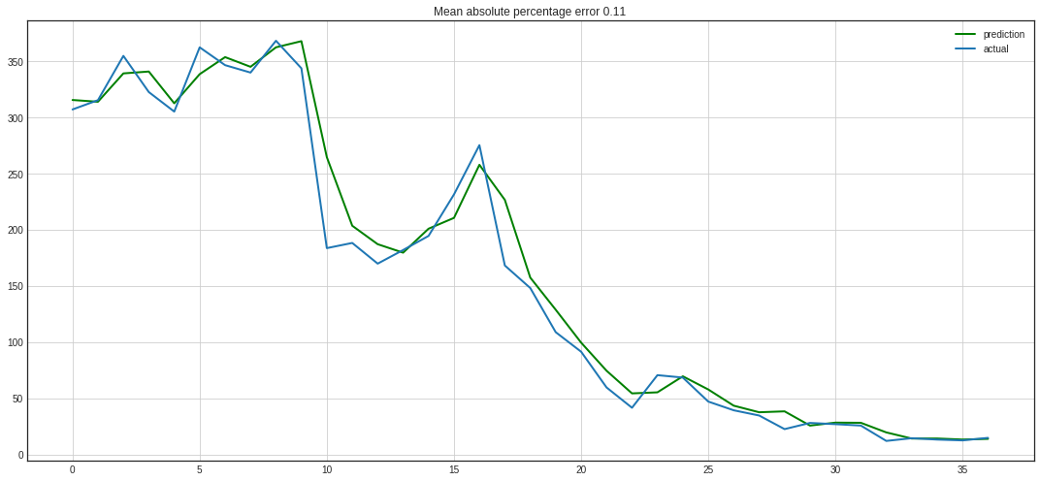

Slide 22
Challenges
Dataset is very small and in improper format
Need to convert the Date value in proper yyyy-mm-dd format
Features are highly correlate with each other

Slide 23
Conclusion
From the Graph of Stock opening price and stock closing price has same results.
From the new_feature attribute and close attributes seem like there is high correlation of each variable.
Bivariate analysis shows high correlation of close price with each other
Graph of “closing price vs date” and “open price vs dates” shows that from date range of 2018-19 there was falling down of stock is started and it becomes 0 in 2020.
We are implemented a linear regression model which gives the accuracy upto 98% and visualize the linear regression model gives best fit model.

